Slide 1
PUTIN’S “PROJECT MAYHEM” The Socio-Psychological Drivers of Putin’s Politics of Ressentiment
A talk for the Centre for Democratic Integrity
5 May 2021
Roger Griffin
(Oxford Brookes University)
“All warfare is based on deception. Hence, when we are able to attack, we must seem unable; when using our forces, we must appear inactive; when we are near, we must make the enemy believe we are far away; when far away, we must make him believe we are near”.
Sun Tzu ‘The Art of War’ (4th century BC)

Slide 2
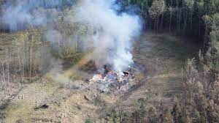
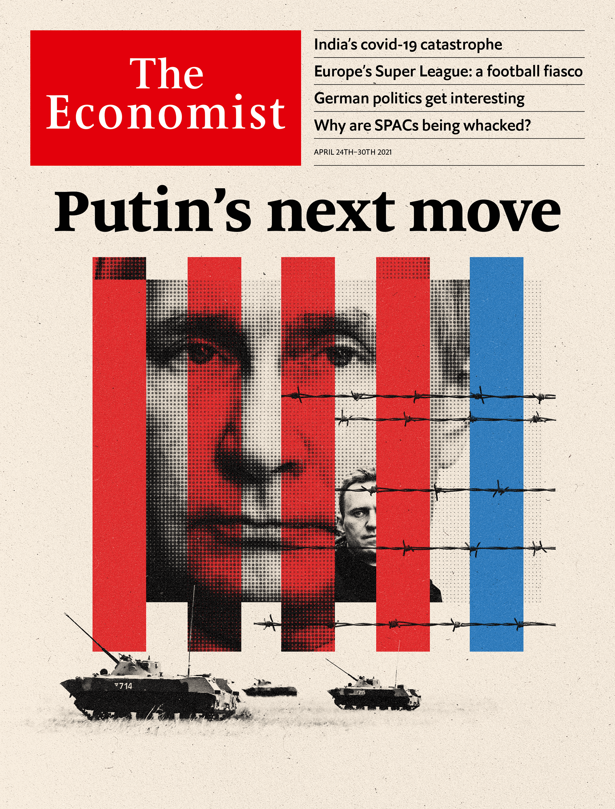
A Czech Explosion, Russian Agents, A Bulgarian Arms Dealer: The Recipe For A Major Spy Scandal In Central Europe
With their leader in prison, Russia’s opposition is on the verge of being driven underground

Slide 3
Putin’s covert war to undermine democracy and boost Russian power/ re-Russify wherever possible
KGB ‘dirty tricks’, undercover murder, misinformation/fake news campaigns feature of Cold War era which shaped Putin as KGB agent (e.g. attempts to link Kennedy assassination to CIA, Black Panthers to Jewish Defence League, HIV to US bio-weapons lab)
A series of indicators of Putin’s determination to repress free speech at home and the hardening of his anti-Western policy, which involved creating a buffer zone of states which were part of Russian as opposed to Western/EU orbit: e.g. 2004-2005 his response to the “Orange revolution” in Ukraine; 2007, Putin’s speech at the Munich Conference on Security Policy: “Russia is a country with a history that spans more than a thousand years and has practically always used the privilege to carry out an independent foreign policy. We are not going to change this tradition today”; 2011-13 Increasingly regressive actions, following protests in Russia; 2014 annexation of the largely Russian-speaking but culturally/politically Ukrainian Crimea, an illegal act in defiance of international law, NATO, UN etc., carried out under the radar of West without any popular mandate, accompanied by covert involvement in Ukraine to stop 2014 democratic revolution, and since then direct support to pro-Russian separatists using Russian equipment and ‘anonymous’ soldiers with view to eventual annexation of ‘Russian’ Ukraine; extensive and overt military support for Assad in Syria; covert support for Lukashenko; the ‘soft’ annexation of Belarus; support for the overthrow of democracy by the Myanmar military regime.

Slide 4
Covert action against Western democracies
Intensive anti-NATO /EU cyber-campaigns (e.g. against Organisation for Security and Cooperation in Europe)
Sponsorship/covert online support for anti-EU, anti-NATO radical right populists (RN, FPÖ, UKIP, anti EU-Ukraine faction in Holland) as well as for far-right BNP, Jobbik, Vlaams Belang, FN, NPD, AfD): in 2015 International Russian Conservative Forum invited 150 representatives of Western Far Right in Moscow (see http://anton-shekhovtsov.blogspot.com/2015/04/what-does-fascist-conference-in-st.html)
Misinformation to stir racism in West (e.g. in Germany fake news about German-Russian child rape by immigrant to incite racist backlash)
Extensive trolling-, bot-, and misinformation campaign to boost Trump support and Trump and undermine/criminalize Hillary Clinton
Likely involvement in German and French elections and in Brexit campaign
Russia’s Internet Research Agency (IRA) accused of carrying out identity theft, wire and bank fraud and conspiracy to defraud America by “impairing, obstructing and defeating the lawful governmental functions of the United States”.
Massive disinformation campaign to blame Ukraine after downing of Malaysia Airlines Flight 17 in 2014

Slide 5
More disinformation
Russia Today and Sputnik created to spread pro-Putin propaganda and fake news about Russia in guise of ‘neutral’ news and current affairs outlets
Various covert activities form part of Russia’s extensive cyberwar against perceived enemies carried out under aegis of Federal Security Service of the Russian Federation (FSB RF), formerly part of KGB, including denial of service attacks, hacker attacks, dissemination of fake news and propaganda, participation of state-sponsored teams in political blogs, internet surveillance, persecution of cyber-dissidents.
An analysis by the US Defense Intelligence Agency (DIA) in 2017 concludes that Russia sees "Information Countermeasures" or IPb (informatsionnoye protivoborstvo) as "strategically decisive and critically important to control its domestic populace and influence adversary states”
Fake ‘election observation’ as tool of electoral interference: see https://www.epde.org/en/news/details/fake-election-observation-as-russias-tool-of-election-interference-the-case-of-afric-2599.html
The DIA divides 'Information Countermeasures' into two categories: "Informational-Technical" and "Informational-Psychological" groups, i.e. i) network operations relating to defence, attack, and exploitation ; ii) "attempts to change people's behaviour or beliefs in favour of Russian governmental objectives.”’
See i) Wiki article ‘Cyberwarfare by Russia’; ii) White House Fact Sheet on Actions in Response to Russian Malicious Cyber Activity and Harassment https://obamawhitehouse.archives.gov/the-press office/2016/12/29/ fact-sheet-actions-response-russian-malicious-cyber-activity-and

Slide 6
War crimes/state murders committed in secret
Russian war crimes committed on Putin’s watch according to Amnesty International and Human Rights Watch include the summary execution of captured enemy combatants and torture in Georgia, Ukraine and Syria.
By 2009, the European Court of Human Rights (ECHR) had issued 115 verdicts finding the Russian government guilty of enforced disappearances, murder, torture in Chechnya (Médecins Sans Frontières also documented war crimes in Chechnya)
The Office of the United Nations High Commissioner for Human Rights (OHCHR) in its 2017 report confirmed that Russia used cluster and incendiary (including barrel bombs) weapons in Syria, constituting the war crime of indiscriminate attacks in a civilian populated area, and also colluded with chemical weapons attacks on defenceless Syrian towns
In 2021 the ECHR also separately found Russia guilty of murder, torture, looting and destruction of homes in Georgia, as well as preventing the return of 20,000 displaced Georgians to their territory.
Note too at least 100 known assassinations and attempted assassinations outside Russia of Putin opponents (e.g. in the UK Litvinenko, Gorbuntsov, Perepilichnyy, Berezovksy, and most notoriously the poisoning of the Skipals leading to Pythonesque interview with RT!), as well as numerous domestic assassinations, disappearances and imprisonments on trumped up charges. Russia involved in intense disinformation campaign against and likely murder of John Le Mesurier, founder of White Helmets. (NB BBC Sounds podcast ‘Mayday’ https://www.bbc.co.uk/programmes/p04sj2pt/episodes/downloads)

Slide 7
How some cartoonists have seen Putin’s politics: the lord of chaos

Slide 8
Working remotely

Slide 9
Putin’s subversive tactics

Slide 10
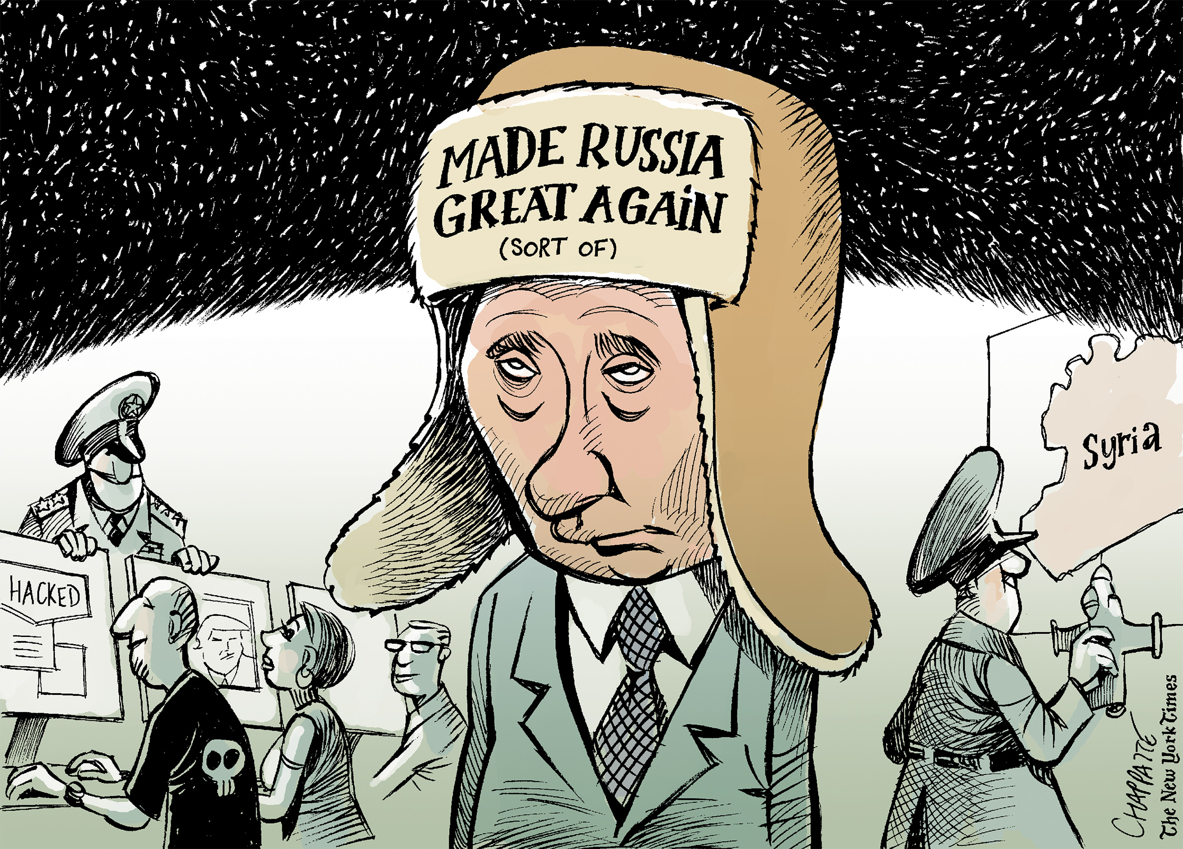
The subverter of democracy to restore Russia’s ‘greatness’

Slide 11
Categorizing Putin’s Politics (see Shekhovtsov’s ‘Conceptualizing Malign Influence of Putin’s Russia in Europe’)
‘soft coercion’: “influence that is indirectly coercive, resting on covert methods (penetration, bribery, blackmail) and on new forms of power, such as energy supply, which are difficult to define as hard or soft”.
‘sharp power’: “malign, aggressive, and manipulative aspects of influence operations of authoritarian states in democratic societies”.
‘dark power’: “the capacity to bully” in a “fearsome and formidable” way so that “rivals are deterred from challenging you, and are inclined to pacify you with deals and exemptions”.
‘maskirovka’: “a set of processes designed to mislead, confuse, and interfere with anyone accurately assessing its plans, objectives, strengths, and weaknesses”.
‘political war’ ”which may be combined with violence, economic pressure, subversion, and diplomacy, but its chief aspect is…the use of propaganda and psychological warfare.”

Slide 12
More concepts relevant to describing Putinesque politics
‘hybrid war’: a blend of conventional militant threat combined with covert forms of aggression
‘information warfare’: “actions taken to preserve the integrity of one’s own information system from exploitation corruption, or disruption, while at the same time exploiting, corrupting, or destroying an adversary’s information system and, [in] the process, achieving an information advantage in the application of force.”
‘disruptive and destructive public diplomacy strategies’: aiming to “probe points of weakness,” “exploit wedge issues,” “redefine the terms of the debate,” “create a counter-narrative,” “galvanize allies,” “divide, co-opt, or marginalize opponents”, “sow confusion, fear and panic” through disinformation, “encourage dissention and defection” and “isolate enemies”.
‘malign’ or ‘malicious influence’ (Shekhovtsov): “influence that directly or indirectly subverts and undermines European values and democratic institutions”.
Note the link in French between ‘maligne’ and ‘malin’ (cunning, underhand, deceptive, furtive, malicious, malevolent). Note too that ‘mischief’ is historically the negative of ‘achieve’, implying realizing ambitions in a corrupt, devious, underhand, illegal way.

Slide 13
Other approaches: Putin as a Machiavellian politician The Prince, XVIII ‘Concerning the way in which princes should keep faith’.
A prince, therefore, being compelled knowingly to adopt the beast, ought to choose the fox and the lion; because the lion cannot defend himself against snares and the fox cannot defend himself against wolves. Therefore, it is necessary to be a fox to discover the snares and a lion to terrify the wolves. Those who rely simply on the lion do not understand what they are about. Therefore a wise lord cannot, nor ought he to, keep faith when such observance may be turned against him, and when the reasons that caused him to pledge it exist no longer.
If men were entirely good this precept would not hold, but because they are bad, and will not keep faith with you, you too are not bound to observe it with them:…he who has known best how to employ the fox has succeeded best. But it is necessary to know well how to disguise this characteristic, and to be a great pretender and dissembler; and men are so simple, and so subject to present necessities, that he who seeks to deceive will always find someone who will allow himself to be deceived.

Slide 14
Picture of Niccolò Machiavelli

Slide 15
MACHIAVELLI’S THIRTEEN RULES FOR THE SUCCESSFUL RULER – TWO VLADIMIR PUTIN DID LEARN; ELEVEN HE DIDN’T, NOT YET http://johnhelmer.net/machiavellis-thirteen-rules-for-the-successful-ruler-two-vladimir-putin-did-learn-eleven-he-didnt-not-yet/

Slide 16
But should we see Putin as a ‘Machiavellian’ politician in a democratic age?
The central character of The White Devil (1612), a tragedy in five acts by John Webster set in late 16th century Italy, focuses on the Machiavellian machinations of a group of ambitious men, notably Francisco de Medici, who uses treachery, subterfuge, covert violence and devious methods rather than open confrontation with his enemies to achieve his ends.
This portrait of all-pervasive intrigue and corruption is typical of politics in late Renaissance and early modern European society
But Putin’s Russia operates in a modern international arena where, after the collapse of the USSR, at least in principle it could have adopted ‘rational’ Enlightenment, democratic principles and participated in transparent global institutions based on universal humanistic values as formulated by the UN.
So we need to probe further into the psychology behind Putin’s perpetuation of the KGB’s covert operations and “dirty tricks”. What drives Putin’s constant recourse to underhand, devious, illusionist, covertly criminal tactics, sometimes involving murder and mass crimes against humanity, to undermine the West and silence alleged enemies of Russia at home and abroad?
We can follow the clue of ‘resentment’

Slide 17
Two fictional treatments of ‘malign influence’ in asymmetric power relationships rooted in traumatic humiliation and pathological resentment/thirst for vengeance
Shakespeare’s Iago in Othello centres on “a Machiavellian schemer and manipulator” whose resentment stems from his conviction that “he has been unfairly passed over for promotion to the rank of Othello's lieutenant in favour of Michael Cassio. Iago plots to manipulate Othello into demoting Cassio, and thereafter to bring about the downfall of Othello himself”.
The Joker (film): studies how Arthur Fleck, a lonely, fragile, but initially compassionate individual suffers bullying, marginalization, public humiliation and ridicule, and unfair dismissal in circumstances of acute social deprivation and cruelty.
The consequent identity crisis and mounting paranoia lead him to forge a sociopathic alter ego prepared to use deception, disguise, deviousness and random acts of murderous violence to enact his mounting hatred of those who ‘fit’/belong in society, which by the end triggers a wave of nihilistic rioting against the system.
This ‘prequel’ highlights the link between socially inflicted trauma > resentment and the evolution of the Joker avatar who will go on to be so devious, sadistic, malignant and nihilistically destructive in his private war against the ‘good’ of Batman and Gotham in the film franchise, driven by his hatred of Batman and his desire to unleash total chaos.
The Joker’s final personality of socio-pathological prankster corresponds to the dark, ‘Shadow’ aspect of the Jungian archetype of the Jester as fool, trickster, prankster, practical joker embodied in the ‘evil clown’ motif recurrent in horror films.

Slide 18
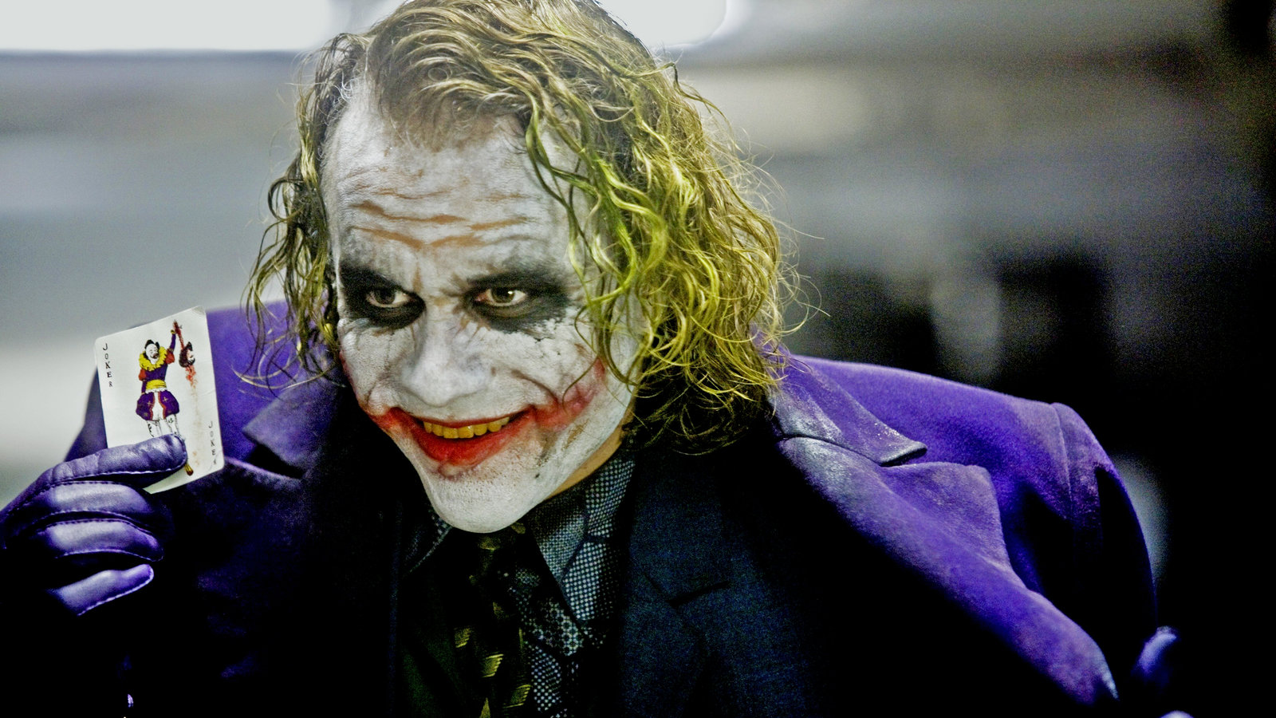
Iago (‘crazy fool, psychopathic racist, or evil genius?’) The Joker (sociopath or nemesis of an uncaring society?)

Slide 19
Some satirists have sensed the covert link with the film

Slide 20
Nietzsche’s concept of ressentiment
In The Genealogy of Morals Nietzsche contrasts those who embody the Master Morality of the ‘higher Self’ or ‘higher human being’ (who live out their ‘will to power’ uninhibited by ‘weak’ ethical considerations based on a fictitious after life) with the ‘Slave Morality’ of those who suffer oppression at their hands and are impotent to challenge/confront them openly.
To overcome a sense of inferiority, worthlessness and nihilism they invert the mythic categories of ‘good’ and ‘bad’, ‘higher’ and ‘lower’ and seek vengeance by developing an obsession with acts of vendetta and retribution that subvert the spiritual confidence, creativity, freedom and joie de vivre of the ‘masters’ and attempt to destroy their hegemony/self-belief/higher self.
The hallmark of those driven by Slave Morality in their grudge war against (those who feel they belong) to a ‘higher’ category of humanity is ‘a persistent, corrosive emotional pattern of resentful hatred against their enemies which Nietzsche calls ressentiment’. https://plato.stanford.edu/entries/nietzsche/

Slide 21
Nietzsche seeks to explain Judeo-Christianity’s deferral of ‘heaven’ to a mythical afterlife, and why it has conducted a war on vitalism, sensual enjoyment, and the BENIGN embrace of the will to power.
He attributes it to the Jews’ need to find existential justification for and dignity/value in their status as slaves of the Egyptians, in their plural diasporas, and in their subsequent subjugation by the Romans, which they achieve in their myth of a Jewish messiah and of being a ‘people chosen by God’
Christians later find the same vindication of withdrawal from life in their inversion of ‘Master/Slave’ values in the Sermon on the Mount which promised that the ‘mighty’ would be humiliated and the ‘meek’ would inherit the earth.

Slide 22
Ressentiment is thus born of an asymmetrical power relation where the weaker party, inwardly convinced of its superiority to those who are now in power/who have achieved hegemony, and nostalgic for former power and glory, are unable to fight back openly to overthrow their alleged oppressors.
They thus develop tactics of subversion (e.g. the Jewish terrorists, the sicarii and the clandestine movement of early Christianity), or a far-reaching campaign to discredit the hegemonic societal power and replace it with their own vision of the world which condemns the dominant one as evil/immoral.
The historic example of this in practice is when under Constantine the Great in the 4th century Christianity was installed as the dominant religion of the Roman Empire (an event that for 17th century historian Edward Gibbon hastened the decline and fall of the Roman empire, the ultimate victory of Slave Morality).

Slide 23
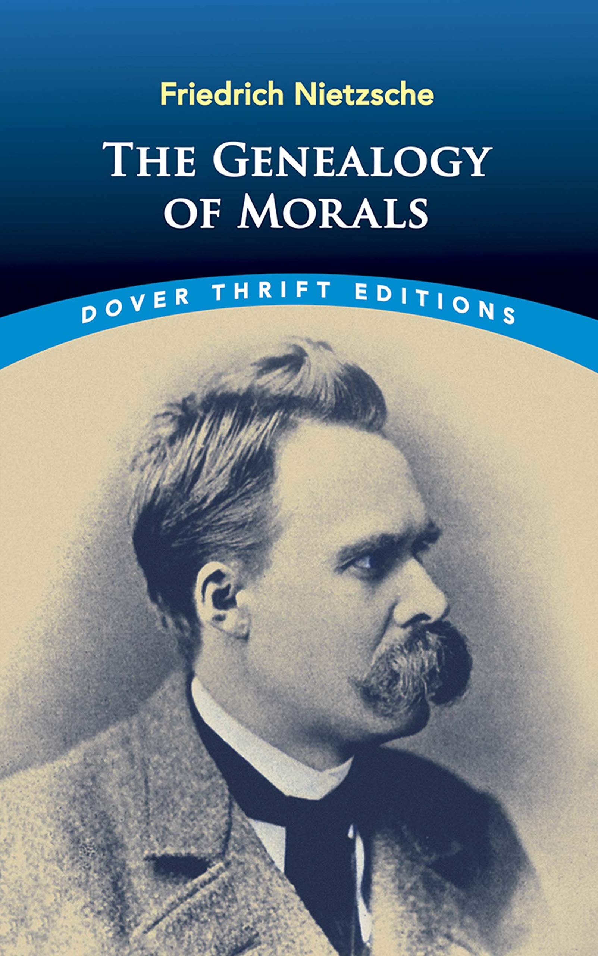
Genealogy of Morals cover

Slide 24
Proposed definition of ‘resentment politics’
‘Resentment politics’ refers to a political mindset and resulting strategy that depends for its effectiveness on the covert actions of agencies officially or unofficially operating on behalf of a non-democratic state, or of extremist movements working independently of an established state but carried out in the name of a threatened (religious) culture. Their purpose is to create mischief, anxiety or fear which will undermine the sense of entitlement, hegemony, invulnerability, and existential security of a legitimate regime, or temporarily interrupt and disable the smooth democratic, administrative or technological functioning of a perceived enemy state, culture or society.
Precluded from deploying the means for conventional interstate confrontation or warfare, the state or extremist movement of the aggrieved society thus resorts to deviousness, subterfuge, dirty tricks, or random terroristic attacks against semiotically significant targets in order to inflict material damage and psychological wounds on the perceived enemy. In doing so, it wreaks symbolic vengeance on the ‘superior’ nation or culture for harm allegedly inflicted, reasserts the heroism of the mythic golden age or former power of the nation or culture of the dispossessed, and demonstrates the unbroken resolve, spirit, national/ communal strength, and essential superiority of the ‘weaker’ society.

Slide 25
Fight Club as a case study in resentment politics

Slide 26
Fight Club’s Project Mayhem as a form of ressentiment politics
THE RESENTMENT “Man, I see in fight club the strongest and smartest men who've ever lived. I see all this potential, and I see squandering. God damn it, an entire generation pumping gas, waiting tables; slaves with white collars. Advertising ... And we're slowly learning that fact. Greed is institutionalized. Advertising has us chasing cars and clothes, working jobs we hate so we can buy shit we don't need. We're the middle children of history, man. No purpose or place. We have no Great War. No Great Depression. Our Great War's a spiritual war... our Great Depression is our lives. We've all been raised on television to believe that one day we'd all be millionaires, and movie gods, and rock stars. But we won't. And we're slowly learning that fact. And we're very, very pissed off. ”
THE RESULTING CLANDESTINE WAR AGAINST SOCIETY “We have front row seats for this theatre of mass destruction. The demolitions committee of Project Mayhem wrapped the foundation columns of a dozen buildings with blasting gelatine. In two minutes primary charges will blow base charges and a few square blocks will be reduced to smouldering rubble. I believe the plan is to blow up the headquarters of these credit card companies, and the TRW building…. If you erase the debt record, then we all go back to zero. It'll create total chaos.”

Slide 27
NB the novel/film can also be seen retrospectively as a Nietzschean rebellion or guerrilla war of a group who has overcome its ‘slave morality’ (of being enslaved to consumerism) to hit back against the existentially and vitalistically hollow ‘masters of the universe’ (i.e. masters of finance) who caused the 2008 crash. However, note that the protagonists of nihilistic, barbaric ressentiment politics always see themselves as operating a higher morality and immoral opponents: cf. the Eurasian myth of Putin’s Russia and the Islamist myth of possessing true Islam

Slide 28
Sources of Putin’s/Russia’s ressentiment
The dramatic collapse of the USSR and the Soviet Empire was a traumatic experience which most Russians were not psychologically prepared for by their social conditioning.
It was followed by a period of extreme socio-economic chaos and political anarchy, but more important a deep existential crisis of direction and identity comparable to Germany 1929-1933, with many symptoms of social breakdown, desperation, conspiracy theories, and the racist nationalism that often accompanies social collapse and acute anomie
The failure of democratization and economic reform on Western lines, Western triumphalism at Soviet failure, and the absence of genuine Western initiatives or intervention to help Russia address urgent socio-economic problems and create a basis for its democratization has led to a wide spread popular resentment and even hatred of the West
Meanwhile within state political, military, industrial and elite circles Cold War attitudes to the West as Russia’s natural enemy were perpetuated and seemed justified by US and EU interference in the Ukraine crisis and plans to extend NATO’s missile defence system

Slide 29
Sample of sources on Putin’s/Russia’s resentment of the West and link to ‘malign influence’
Taras Kuzio, ‘Why Vladimir Putin is Angry with the West: Understanding the Drivers of Russia’s Information, Cyber and Hybrid War’, Federal Academy for Security Policy no. 7, Jan. 1, 2017, https://www.jstor.org/stable/resrep22206
Maria Lipman, ‘How Russia has come to loathe the West: ‘In the quarter century of post-Soviet development, resentment towards the West has been accumulating to a broad, genuine and raw hatred’, European Council on Foreign Relations, March 2015, https://ecfr.eu/article/commentary_how_russia_has_come_to_loathe_the_west311346/)
James Kirchik, ‘Russia’s plot against the West’ , Politico March 2017, https://www.politico.eu/article/russia-plot-against-the-west-vladimir-putin-donald-trump-europe/
‘How Russians See the West’, The Economist, 8 May 2015, https://www.economist.com/the-economist-explains/2015/05/07/how-russians-see-the-west
‘Putin's Information Warfare In Ukraine: Soviet Origins of Russia's Hybrid Warfare’, Institute for the Study of War, http://www.understandingwar.org/report/putins-information-warfare-ukraine-soviet-origins-russias-hybrid-warfare

Slide 30
The context of national identity crisis that encouraged popular support for Putin’s Project Mayhem
The constitutional crisis of 1993 which nearly plunged Russia into civil war, the socio-economic and existential pain that accompanied the transition to a capitalist economy, and the sense of Russia’s rapid decline from its superpower status after initial boom under Boris Yeltsin led to rapid disillusionment with ‘democracy’, nostalgia for USSR, a deepening identity crisis, Yeltsin’s increasing unpopularity and final resignation in 1999
However, it created the ideal context for Putin to fill the power vacuum after Yeltsin’, given wide-spread popular longings for a strong leader who would impose order on a collapsing society, restore national strength, autonomy and pride, and demonstrate the ability for Russia to once again stand up to West and threats to its sovereignty as in Soviet Era
As a former KGB agent schooled in Cold War paranoia, the USSR’s ruthless techniques of social engineering and extensive capacity for covert war, Putin was perfectly placed to use duplicity and propaganda to ‘make Russia (feel) great again’ by promoting the traditional self-image of Russians as a vast, powerful, inscrutable historical nation occupying a special place between West and East, and endowed with vast resources and a unique national genius that made it a natural, organic superpower enigmatic to the non-Slav West (cf. Dostoevsky)

Slide 31
The popular resonance of Putin’s neo-KGB mindset
But at the same time after 1991 the myth of the Russians as a ‘master race’ (cf. Bolsheviks’ ‘New Soviet Man’) had been undermined by combination of political paralysis, the deep socio-economic crisis and insecurity for the vast majority plus the permanent threat posed to Russia by the perceived enmity and aggression of the West and its encirclement by hostile Islamic nations (a narrative reinforced by Soviet failure in Afghanistan, the wars in Chechnya and Dagestan and continued Chechen terrorism).
There thus developed an elective affinity (comparable to that between Hitler and Germans after 1929) between Putin’s strategy to adapt Soviet domestic and foreign state policy to the new ‘democratic’ and oligarchic Russia and the millions of Russians now longing to feel a renewed sense of defiant Russian ‘Eurasian’ identity, national pride, national strength, and revitalized potency
The result was Putinism’s gathering momentum as a genuine populist movement based on his macho style of charismatic leadership, especially after his right-wing turn in 2007.
His powerful support licensed the extinction of democracy by kleptocracy and of openness by pervasive corruption which stifled basic human freedoms at home and by the systematic use of dirty tricks abroad under the cloak of modernized version of the traditional Russian secret and terror state, while the masses colluded with the mutation of Russian presidency legalizing Putin’s protracted personal dictatorship

Slide 32
Russia’s anti-democratic hypernationalism as compensatory myth for failure to build a successful democracy and powerful, respected Russia
Putin thus encouraged his paradoxical image as a charismatic personal dictator heading a constitutional state, a strategy made easier by Russia’s rapid economic growth and modernization in the first phase of his presidency.
His dominance of Russian politics after 1999 encouraged a supercharged nationalism and racism conceived in the spirit of ‘Eurasianism’ which provides a popular support base for Putin’s demonstrations of Russian strength, his hostility to the US, NATO, the EU and Western policy towards Syria, and his persecution of domestic democratic and liberal reformers
Putin’s personality cult rooted in a shared resentment at the collapse of the Soviet Empire, the loss of Russia’s Superpower status, and the bitter realization of how much the Soviet Dream was a mirage
This populist consensus remained relatively strong till late 2010s despite the visible decline in standard of living being experienced by millions and growth of popular support for dissidents.
It is on this basis that Putin in his heyday was able to refine and extend his ‘politics of ressentiment’ and ‘malign influence’ towards the West: it resonated with the general mood of anomie, identity crisis, paranoia and repressed anger among large segments of disaffected, impoverished and desperate Russians

Slide 33
The cogency of this approach depends on degree to which the pro-Putin segment of Russian population can be treated as a single organism or ‘group mind’
The vision of society as a single body/organism is an ancient trope: e.g.
The Confucian concept of society as a ‘family’
The Greek concept of ‘zoon politikon’
The Cabbalistic Adam Kadmon
The Christian notion of ‘the body of the Church’
The medieval concept of ‘body politic’
Da Vinci’s ‘Vetruvian Man’
Hobbes’ concept of the nation as a Leviathan
The supraindividual ‘national community’/ Volksgemeinschaft identified with the leader in several fascist traditions
The Nazi ‘Volkskörper’
Meinecke on the nation as ‘macroanthropos’

Slide 34
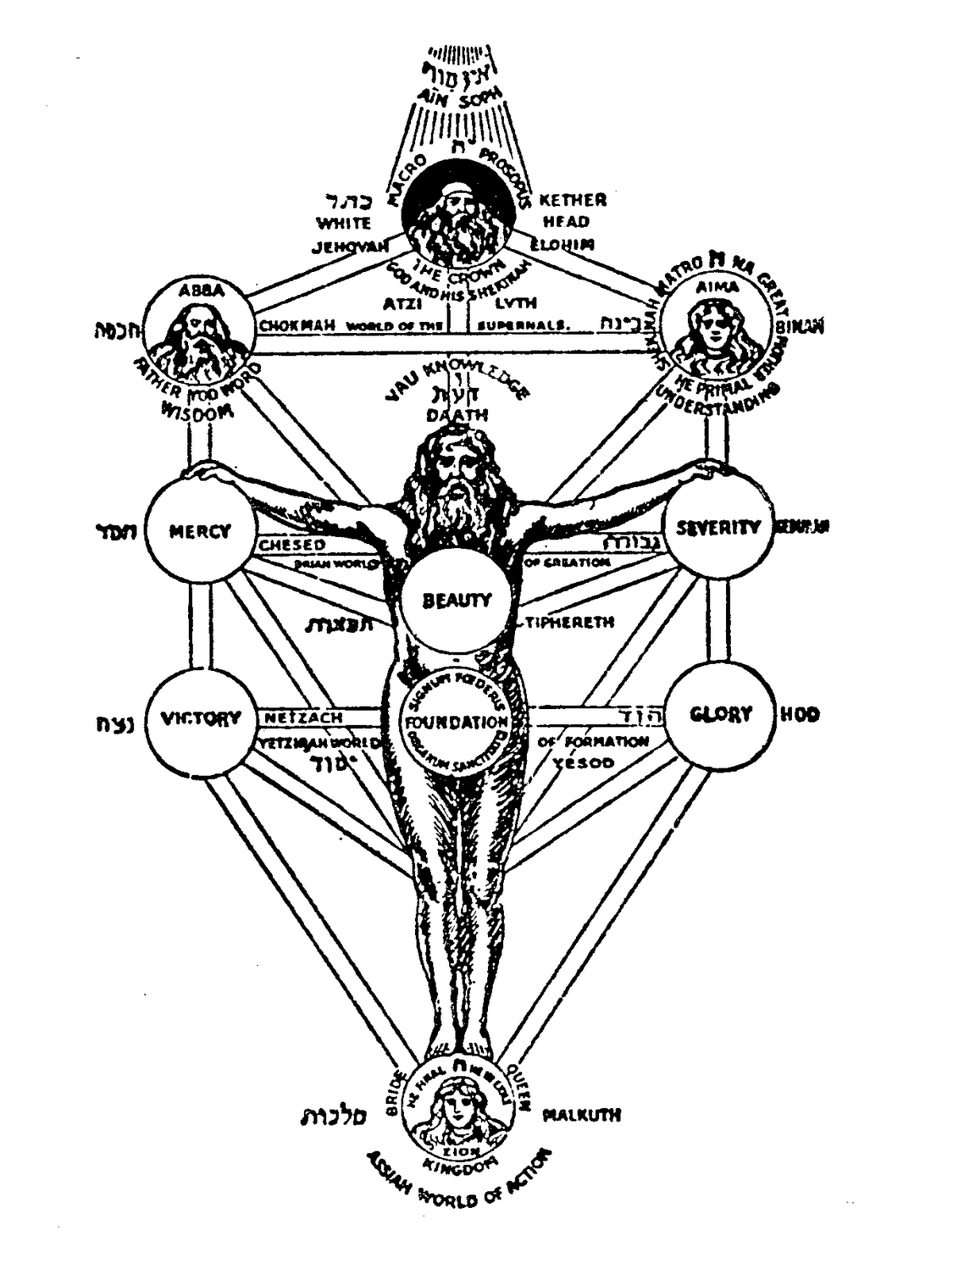
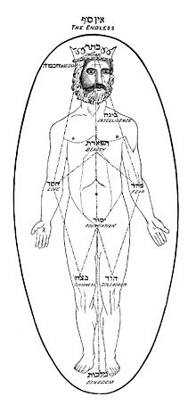
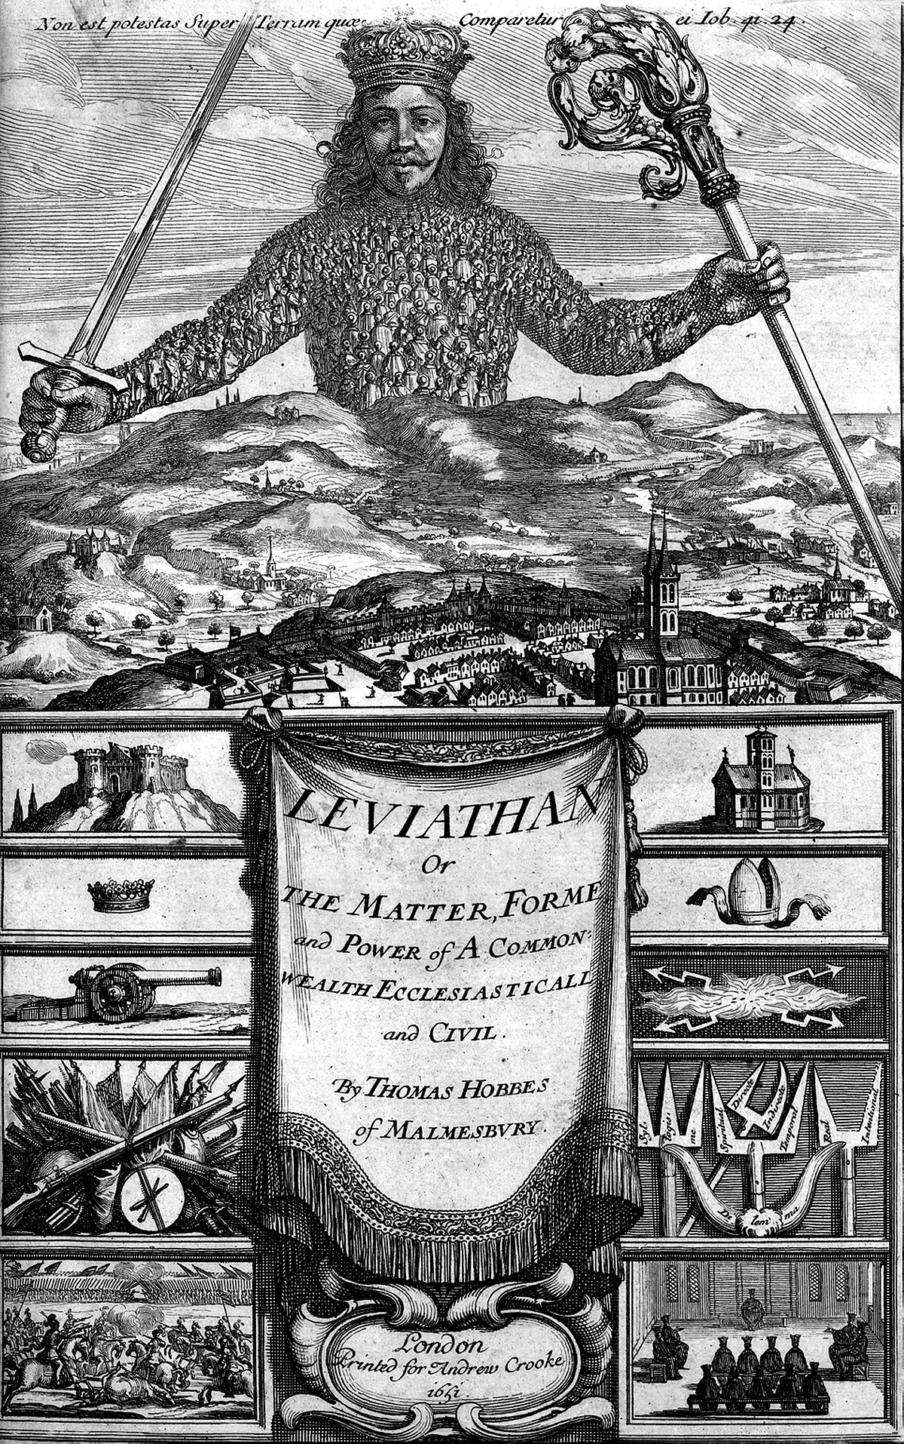
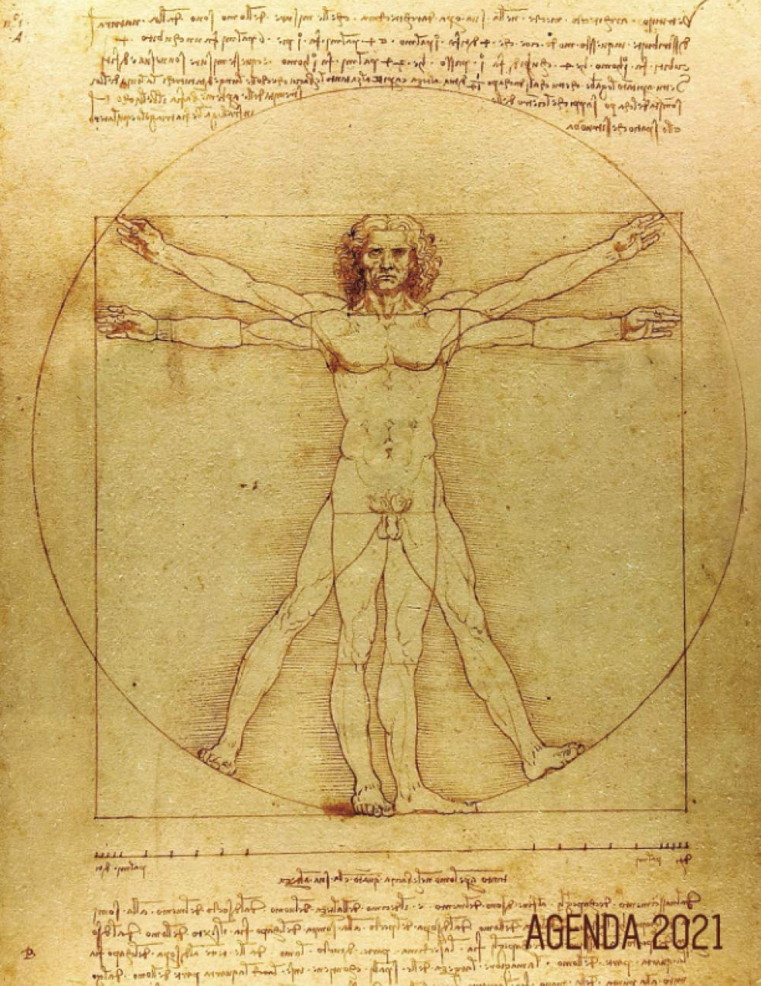

Slide 35
The methodological issues raised by psychoanalytical accounts of political behaviour
Obvious mythic/metaphorical element in notion of the ‘body politic’/ Volkskörper which can be treated as functioning psychologically/emotionally as a single person with talk of humiliation, resentment, disillusion: a problematic mental shorthand raising numerous questions: e.g.
Which psychoanalytical, psychological, psychiatric model to apply, since multiple conflicting models exist in psychological studies?
How legitimate it is to see a state’s foreign policy in terms of irrational forms of individual psychology/psychopathology/psychiatric/psychoanalytic terms rather than responses to situations by vulnerable individual politicians?
How does the relationship between the leader/state elites and ‘the public’/ the ‘people’/ ‘the masses’/ the ‘nation’ actually work psychodynamically?
How far is mass popularity the symptom of some profound resonance or shallow conformism/herd mentality?
How far can academics and journalists avoid succumbing to nationalist/racist stereotyping and impressionist generalization in positing a collective social/ national personality, psyche, character, political culture?
Is it empirically justified to talk of national psyche/psychology/character?
But since Putin and millions of Russians experienced the collective trauma of transition to ‘democracy’ and ‘capitalism’ powerful currents of similar emotions make sense (cf. different national reactions to Covid/lockdown).

Slide 36
The heuristic value of ‘resentment politics’ in other contexts: I North Korea
US seen as the military enemy in the Korean War, the cause of Korea’s division, and as bent upon the annihilation of the North, while the West is simultaneously envied as vastly superior in ever field: hence state paranoia and a permanently politicized han “an internalized feeling of deep sorrow, resentment, grief, regret and anger” at country’s encirclement by hostile powers. Result: extensive use of malign tactics. (NB Paul French, North Korea: A State of Paranoia)
The US Joint Strategy Review definition of 1999 describes “asymmetric military strategy” as using “innovative, non-traditional tactics, weapons, or technologies and can be applied at all levels of warfare—strategic, operational, and tactical—and across the spectrum of military operations”. They are all attempts “to circumvent or undermine US strengths while exploiting US weaknesses using methods that differ significantly from the United States’ expected method of operations”, and” a major psychological impact, such as shock or confusion that affects an opponent’s initiative, freedom of action, or will.”
North Korean hackers have “stolen billions of dollars…paralyzed the United Kingdom’s National Health Service and hacked India’s newest nuclear power plant to steal its designs.” They have gone from spying on and disrupting their South Korean adversaries to stealing large sums of money, robbing cutting-edge technology, and causing havoc” and are “potentially a bigger threat than the massive rockets North Korean leader Kim Jong Un parades around every year.
https://foreignpolicy.com/2021/03/15/north-korea-missiles-cyberattack-hacker-armies-crime/

Slide 37
II: Right-wing populism as resentment politics
Radical right populism fed by alarm at national decline, nostalgia for (highly mythicized past glory, national cohesion, and shared identity, resentment of migrants and refugees, anxiety as erosion of ‘sovereignty’ Racist extremism and terrorism: e.g.
In former GDR, waves of extremism/racist populism rooted in years of envy of West followed by the trauma of unification, loss of DGR securities, unemployment and identity, leading to rise of populist racism and neo-Nazism as resentment politics expressed in clandestine war against migrants, Jews, communists, EU etc.
This is clear from analysis of racist campaigns in Chemnitz, Hoyerswerda, Jena, Dresden), National Front, Front National, Le Lega in Italy, AfD in Germany etc.
BUT ABOVE ALL TRUMP AND TRUMPISM
See i) Hans-George Betz, ‘The New Politics of Resentment: Radical Right-Wing Populist Parties in Western Europe’, Comparative Politics , Jul., 1993, Vol. 25, No. 4 (Jul., 1993), pp. 413-427 ); ii) Lawrence Rosenthal, ‘Empire of resentment [on Trumpism]’, Open Democracy, 4 October 2020; iii) “Researchers point to populism’s appeal to victimhood and resentment A new study from the Department of Politics and International Studies at the University of Warwick combines research on populist rhetoric, emotions and security in order to examine how particular groups of voters are mobilized: “The article argues that populists like Donald Trump, Marine Le Pen, or some Brexit campaigners, construct fantasies of past national greatness and belonging to instil audiences with a sense of pride and nostalgia. At the same time, these political entrepreneurs use rhetoric that targets feelings of resentment and anger, representing themselves and their audiences as victims of the establishment.” https://warwick.ac.uk/newsandevents/pressreleases/researchers_point_to/

Slide 38
III: Islamism as resentment politics
The ‘dirty’ war fought by Islamism against the West with its repeated multiple atrocities and attempts to disrupt and undermine the psychological security and the smooth functioning of advanced societies can be seen as a response to i) the sense of cultural, imperial and technological eclipse of the Islamic World by the ‘Christian’ West despite its enormous medieval empire which was culturally, scientifically, and technologically superior, ii) the existential crisis of Islam as a faith in a secularizing and globalizing world; iii) recent humiliations in the relations between Arab nations and a West-backed Israel.
Note the ‘devious’, underhand, barbaric tactics and strategies of Al Qaeda, Taliban and Isis typical of ressentiment
See: Michael Sharnhof, ‘A humiliated Arab world turns to Islamism’: “After the Six Day War Pan-Arabism’s decline created a vacuum that was filled by Islamists”
E. Brigi, ‘The Globalisation of Resentment: Failure, Denial, and Violence in World Politics’, Westminster Politics https://core.ac.uk/download/pdf/161104664.pdf

Slide 39
Footnote: the waning power and unsustainability of Putin’s resentment politics
Brian Taylor, ‘Putin’s Rules of the Game: The Pitfalls of Russia’s New Constitution’ Foreign Affairs, April 12, 2021
Bo Petersson, ‘Putin and the Russian Mythscape: Dilemmas of Charismatic Legitimacy’ Demokratizatsiya, (2017) Vol. 25, no 3, pp. 235-254
Richard Tempest, ‘The Charismatic Body Politics of President Putin’,
Journal of Political Marketing (2016), Vol. 15, Nos. 2-3, pp. 101-119
https://www.tandfonline.com/doi/abs/10.1080/15377857.2016.1151105?journalCode=wplm20
Joshua Yaffa, ‘How the Coronavirus Revealed the Hollowness of Putin’s “Vertical of Power”’, The New Yorker, May 26, 2020.
‘The pandemic has shown that Vladimir Putin’s system is better at fostering a kind of psychic or virtual power than wielding real power in a time of genuine crisis.’

Slide 40
Meanwhile Putin is determined to remain the face of Russia

